Slide 1
Altera (Intel) Embedded Design Environment
Week 1 Lecture 3

Slide 2
HW and SW design
Embedded System Design Flow
Hardware design flow
Ex: VHDL, Verilog, etc
Software design flow
Ex: C, Assembly
Altera Design Environment
Supports both hardware and software flow
Hardware implementation done by Quartus II
Software implementation done by Nios II Embedded Design Suite (EDS)

Slide 3
HW and SW Design

Slide 4
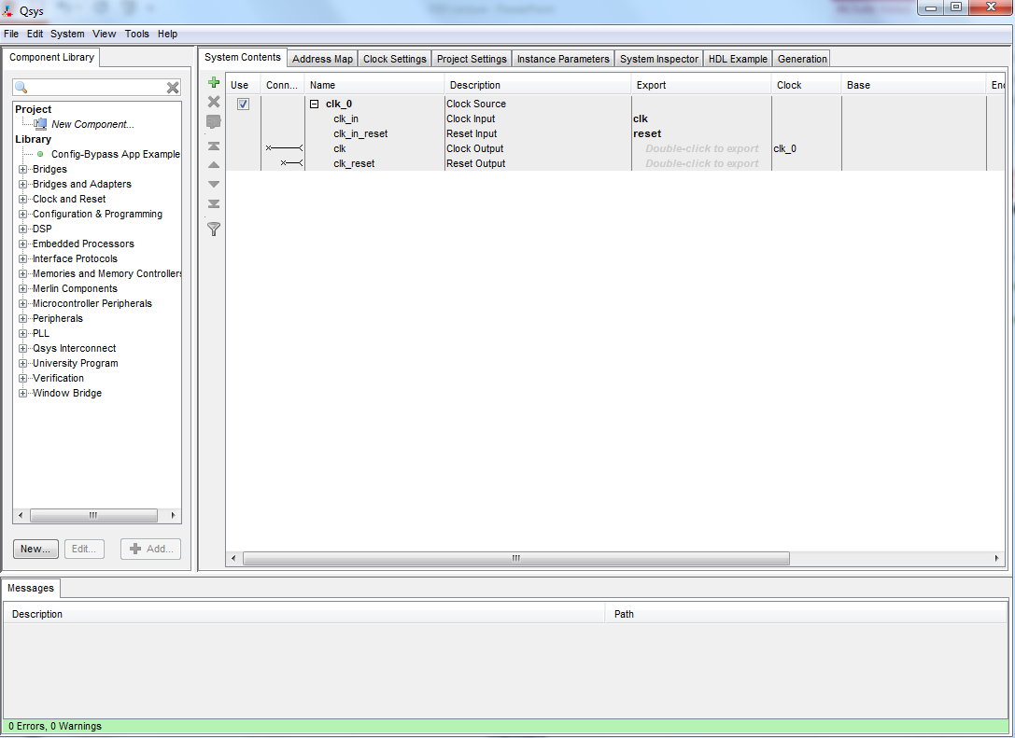
QSYS/Platform Designer(PD) System Builder
Main PD Tabs
Component Library
System Contents
Messages

Slide 5
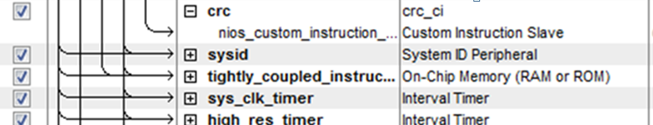
Platform Designer
Platform Designer System Builder
System ID Peripheral
Used to ensure hardware/software version are synchronized
Simple 2 registers
Timestamp
Random number
Debugger checks when downloading software to hardware
Most common connection problem
Hardware needs to be recompiled and downloaded
Can be read at runtime to make sure correct hardware is present

Slide 6
Platform Designer
PD System Builder
Generates synthesizable output files of the hardware system
Includes the NIOS II processor and IP cores
Compiled with the Quartus II software
Generates “PD Interconnect” to connect components together
Avalon-MM (Memory Mapped) interfaces
E.g. Nios II instruction and data masters
Avalon-ST (Streaming) interface
XML file used by software tools
Describes hardware for software build process

Slide 7
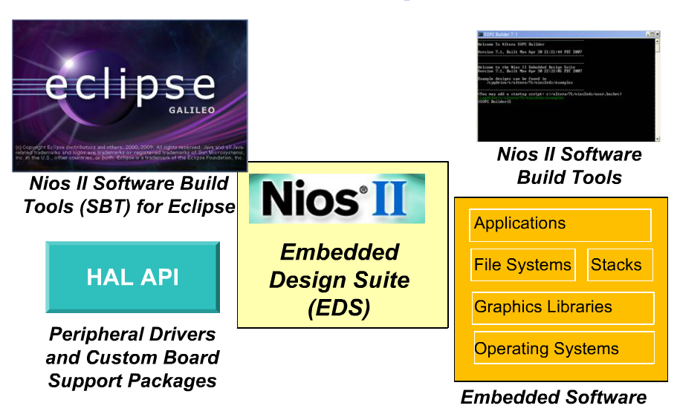
SW Environment

Slide 8
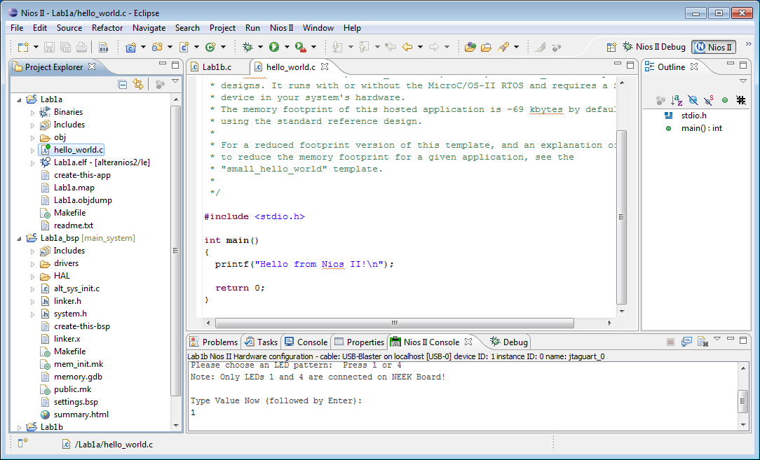
Software Build Tools
Select Perspective
Note: NIOS II
File Viewer
Outline View
(View functions, enums, classes, structs etc.)
Projects
Terminal Window

Slide 9
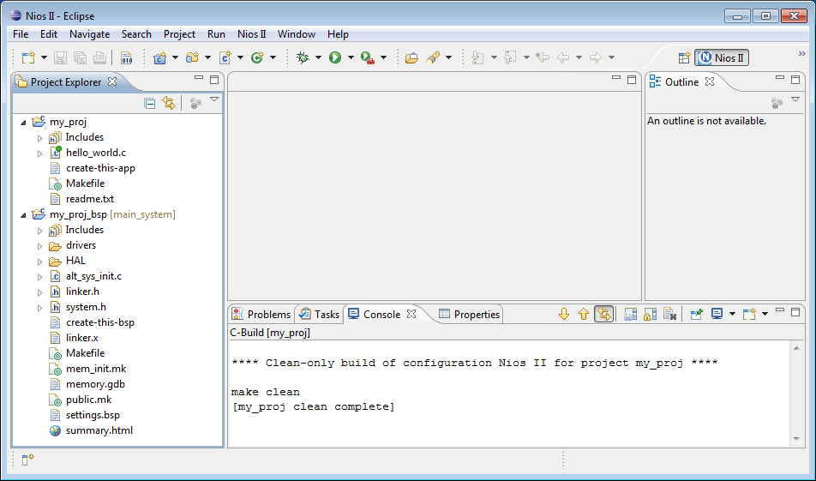
Software Build Tools
Application project
(Contains application source code)
Note: NIOS II
BSP project
(Contains system header file and links to device driver source code)

Slide 10
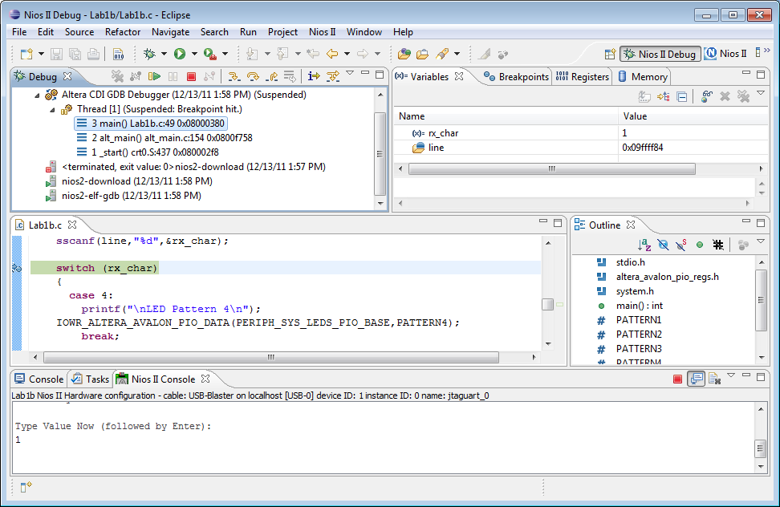
Software Build Tools
Debug project
Run project
Perspective Selector
View/modify
(Variables, registers, memory…)
Note: Debug
Double-click to add breakpoints

Slide 11
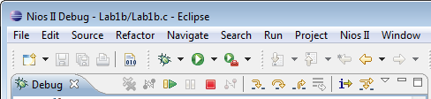
Debug Perspective
Resume
Suspend
Terminate
Step Into
Step Over
Step Return

Slide 12
Generated Files
Important Files
Quartus Project File (*.QPF)
Text file that contains basic information about the current version of the Quartus II software and the date
It also lists all of the revisions created for the project
Quartus Settings File (*.QSF)
Text File that contains all of the project-wide and entity-level assignments and settings for the current revision of the project.
Quartus System File (*.QSYS)
Text file that records system designed in Platform Designer application
Contains project name, module names, interface connection, parameters for system

Slide 13
Generated Files
Important Files
Quartus IP File (*.QIP)
Text File that contains path to all the files for IP cores
Allows you to add required files to Quartus project by adding this file to Quartus instead of adding them individually to Quartus
Regenerated when PD design is generated
Added automatically to project when PD opened within new project
Executable and Linkable Format (elf file )
Located in Application Project Folder
Executable and linkable format, compiled output code for download
System description header file: System.h
Generated with BSP (located in BSP folder)
Contains memory map of peripherals and symbolic names

Slide 14
Software Projects
Nios II Software Project Types
BSP
Specialized library containing system-specific support code
Provides software runtime environment customized for processor in Nios II hardware system
Contains HAL and device drivers
HAL provide abstraction away from hardware to make software coding easier
Application Project
Contains user code
Also consists of a collection of source code and makefile
Used to create executable to run on Nios II processor

Slide 15
Other Tools
SignalTap II Logic Analyzer
Embedded Logic Analyzer internal to FPGA
Allows you to capture signal in your design
Capture at full system speed
Uses memory resources to store samples
Can be used with Nios II Eclipse
SignalProbe
Routes signals under debug out to spare/reserved pins

